Slide 1

Easy Finance – Process Definitions
Digitalization China
Augst 2018

Slide 2
EF-EP-007
EPIC:
As BMW SF eAPP Owner I have to do online customer identity authentication thus to acquire customer pboc authorization.

Slide 3
EF-EP-007: E-AutheNtication
Story ID: EP007-S001-DW:
As a user of eAPP, I want to see the overall E-Application including E-authentication process and required materials, so that I can know the process and prepare materials in advance.
Story ID: EP007-S002-DW:
As BMW SF eAPP Owner, I want the eAPP user to upload PRC ID information for both sides, so that BMW SF can perform NCIIC online identity authentication to the applicant.
Story ID: EP007-S003-DW:
As BMW SF eAPP Owner, I want the eAPP user to upload Bank Card information, so that BMW SF can perform China Union Pay online identity authentication to the applicant.
Story ID: EP007-S004-DW:
As BMW SF eAPP Owner, I want the eAPP user to perform Face Recognition, so that BMW SF can continue to acquire PBOC authorization from the applicant if he/she passed Face Recognition and Vivo Detection.

Slide 4
EF-EP-007: E-AutheNtication
Story ID: EP007-S005-DW:
As BMW SF eAPP Owner, I want to show the E-Authentication Result to the user, so that the user can continue or stop the journey.
Story ID: EP007-S006-DW:
As BMW SF eAPP Owner, I want to generate CA for E-Athentication, so that all the customer actions, including authentication and authorization, can be saved as digital evidence.
Story ID: EP007-S007-DW(out of MVP):
As a eAPP user, I want to have the information in OSS that was used to do Union Pay Bank Card 5 elements verification in E-Application, so that the information can be prefilled when I do Direct Debit in OSS platform.

Slide 5
Story ID: EP007-S001-DW:
OWNER: PO
Business
Legal
As a user of eAPP, I want to see the overall E-Application including E-authentication process and required materials, so that I can know the process and prepare materials in advance.
Assumptions:
Pre-Conditions:
The user has logged in eAPP.
Acceptance Criteria:
After customer confirmed quotation and dealer confirmed the transaction price, eAPP will show a Process Overview page with the following application steps, including E-Authentication.
First part of the page includes material needs to be prepared by the applicant, including PRC ID card, Bank Card, etc.
Second part of the page includes notes: please make sure the reserved phone number for bank card can receive short message.
Third part of the page includes Process Overview of E-Authentication and following steps, including:
Select dealer, vehicle and SF product
Online Identity Authentication, Face Recognition and PBOC Authorization
Personal Information and Application Form
Document upload & get application result
After the user click “next step”, eAPP will start the product selection step.
Security
Compliance

Slide 6
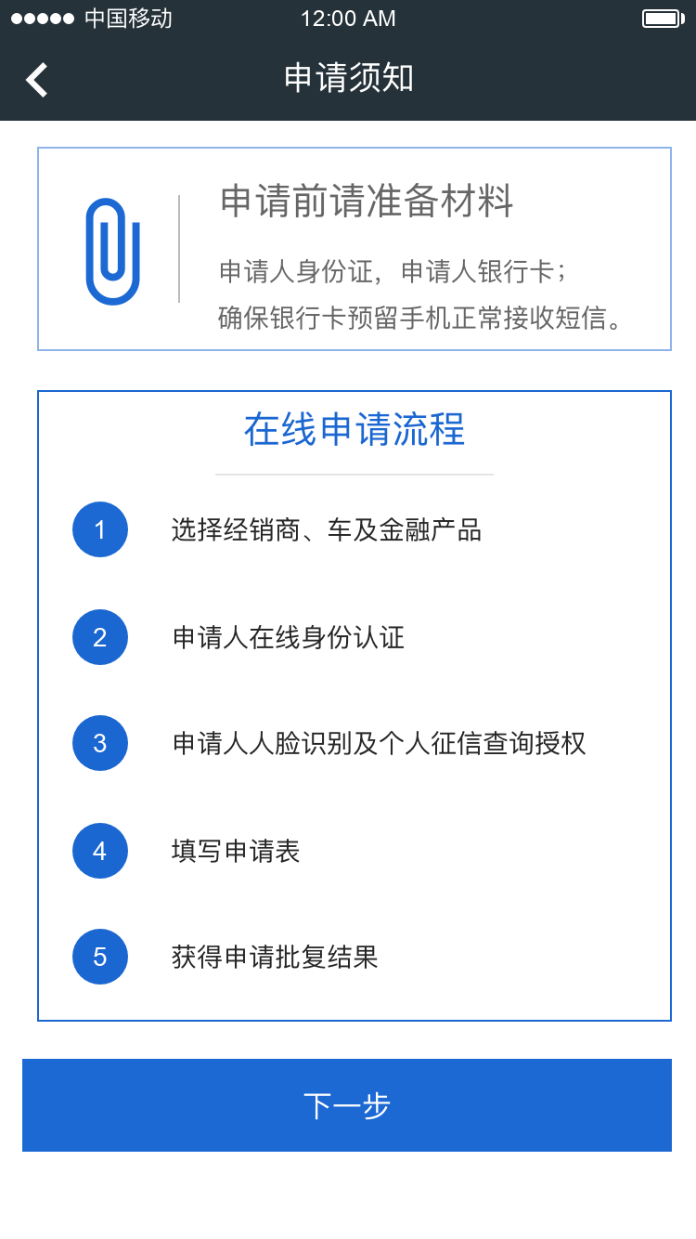
Story ID: EP007-S004-DW:
Mockup

Slide 7
Story ID: EP007-S002-DW:
OWNER: PO
Business
Legal
As BMW SF eAPP Owner, I want the eAPP user to upload PRC ID information for both sides, so that BMW SF can perform NCIIC online identity authentication to the applicant.
Assumptions:
Pre-Conditions:
The user has logged in eAPP.
The user has selected the dealer, vehicle and SF product.
Quotation has been confirmed by the customer.
Transaction price has been approved by dealer.
Acceptance Criteria:
When the user enters E-Authentication Process, the first step will ask customer to upload PRC ID personal image side.
Customer can only shoot directly from Physical PRC ID but can not choose the picture from album. (Dee’s Suggestion)
After customer click “start shooting” button on the page, the camera will be automatically turned on and OCR will be triggered to read Name, ID Number from the personal image side.
In the back-end, the information collected by OCR – Name and ID Number – will be sent to NCIIC interface provided by 3rd party, and the interface will return the result: Consistent or Not Consistent.
If the result is Not Consistent, eAPP front end page will show message to customer “the ID information you provided does not pass identity verification, please contact dealer or try again…” and the user CANNOT continue to next step.
If the result is Consistent, eAPP front end page will show the recognized Name and ID number, and all the data will be saved. The user Now can continue to upload PRC ID national emblem side.
Security
Compliance

Slide 8
Story ID: EP007-S002-DW:
[Cont.] Acceptance Criteria:
Customer can only shoot directly from Physical PRC ID but can not choose the picture from album. (Dee’s Suggestion)
After customer click “start shooting” button on the page, the camera will be automatically turned on and OCR will be triggered to read “Authority” and “Valid Period” from the national emblem side.
In the back-end, eAPP should judge whether the ID is Expired or Valid with the recognized valid period information. If the ID is expired, eAPP front end page will show message to the user “Sorry, your ID card has expired, please use an valid card to do identity authentication and continue your journey.”
If the ID is valid, eAPP front end will show the recognized “Authority” and “Valid Period”, and all the data will be saved. The user Now can continue to upload Bank Card and continue the application.

Slide 9
Story ID: EP007-S003-DW:
OWNER: PO
Business
Legal
As BMW SF eAPP Owner, I want the eAPP user to upload Bank Card information, so that BMW SF can perform China Union Pay online identity authentication to the applicant.
Assumptions:
Pre-Conditions:
The user has passed PRC ID online identity authentication and the ID is valid, user story EP007-S001-DW.
Acceptance Criteria:
After the user successfully uploaded PRC ID two sides, passed NCIIC identity authentication and the ID is valid, customer can click next step to continue update Bank Card information.
Customer can shoot directly from Physical bank card or choose the picture from album. (Dee’s Suggestion)
After customer click “start shooting” button on the page, the camera will be automatically turned on and OCR will be triggered to read Bank Card Number from the physical bank card.
After OCR, in eAPP front end page, recognized bank card number will show on the page and the information is editable. Because the OCR result of bank card number is not 100% accurate for all card. User can manually modify the bank card number.
In the same front-end page, besides the bank card number, it will show user’s phone number that is auto-filled with the phone number used for account registration. Also, the phone number is editable and user can manually modify the number if it is not the one used to registration the bank account.
In the same front-end page, below the phone number row, SMS verification code is requested. After the user click “Acquire Verification Code”, the phone will receive 4/6 digits.
Security
Compliance

Slide 10
Story ID: EP007-S003-DW:
[Cont.] Acceptance Criteria:
After the user filled the 4/6 digits, back-end will verify the code is correct or not. If the filled verification code is wrong, the error messages pop-up window will appear and says: “Mobile Phone Verification number is wrong, please check the phone number and try once again.”
If the code is correct, “Next Step” button can be clicked. After the user clicked the button, Name, ID number, Bank Card Number and Mobile Phone Number will be sent to China Union Pay Interface (provided by 3rd party) for identity verification. The Interface will return the verification result, Consistent or Not Consistent.
If the information is Not Consistent, i.e. some of the information is not consistent with the information used to register bank card, eAPP front-end will show message to the user:“Sorry, the information you provided has not passed Union Pay identity verification, please check the information and try again, or contact your dealer for help…”
If the information is Consistent, eAPP will save all the information in the back-end and will start the PBOC Authorization Process.

Slide 11
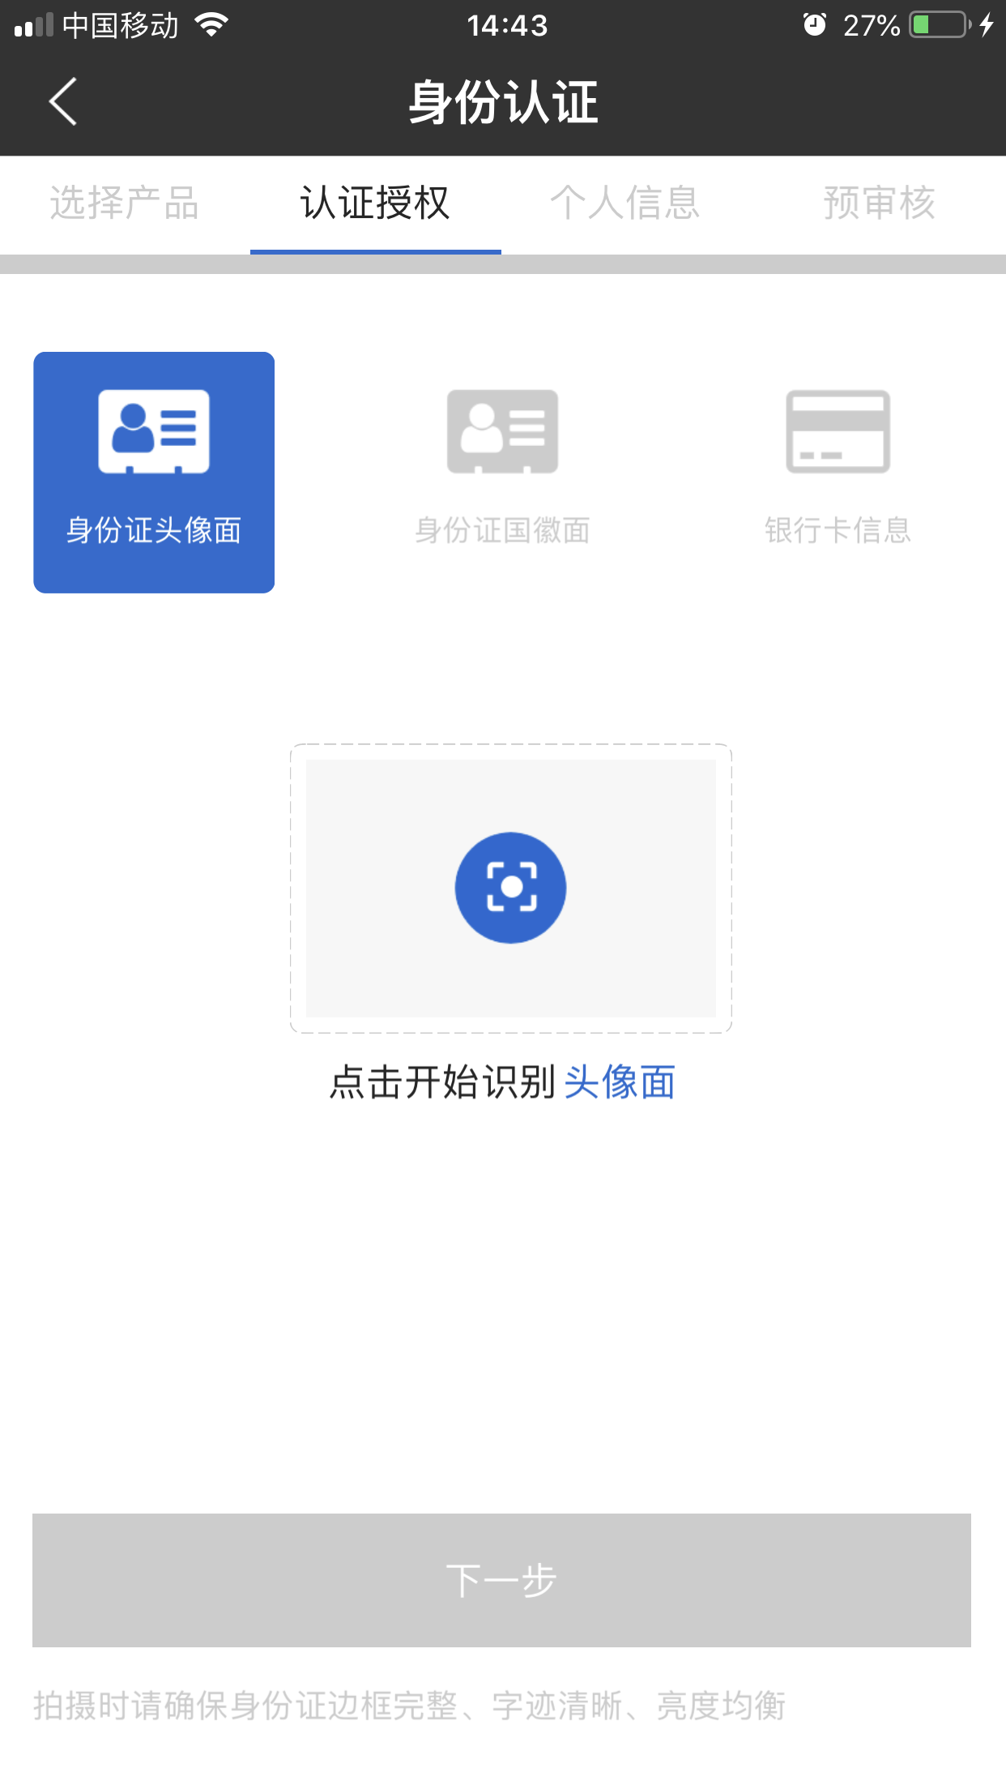
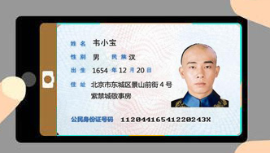
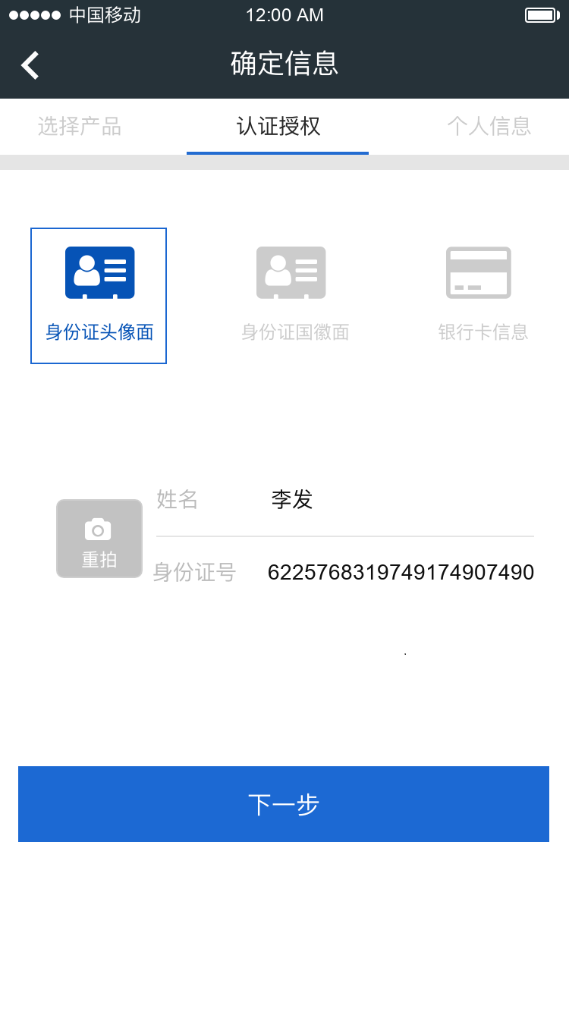

Story ID: EP007-S002-DW
Mockup
OCR PRC ID – Head Image side
Name and ID number by OCR

Slide 12
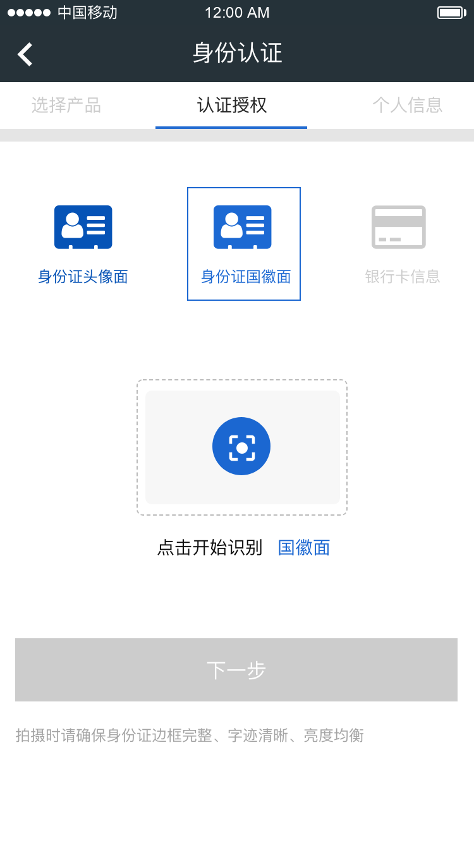
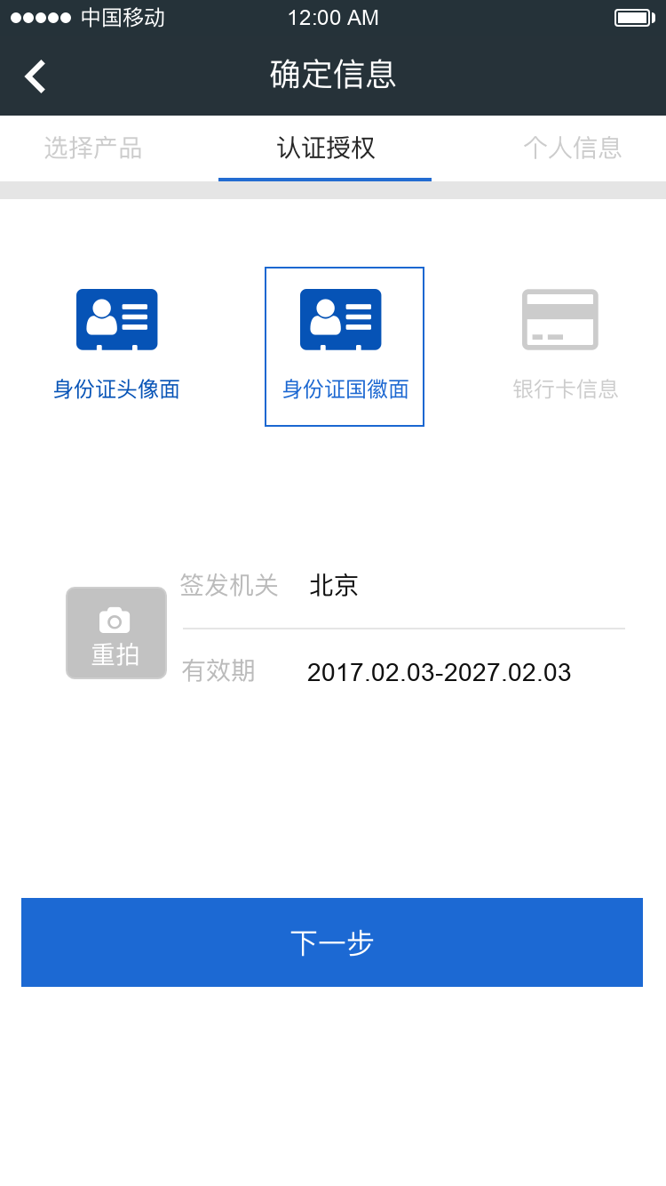
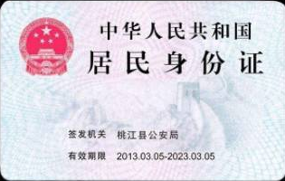
Story ID: EP007-S002-DW
Mockup
OCR PRC ID – National Emblem side
Issue Authority and Valid Terms by OCR

Slide 13
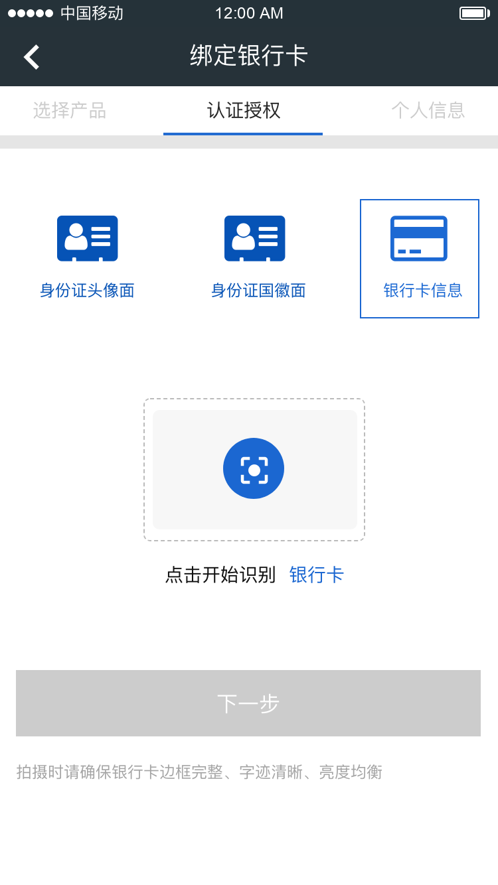
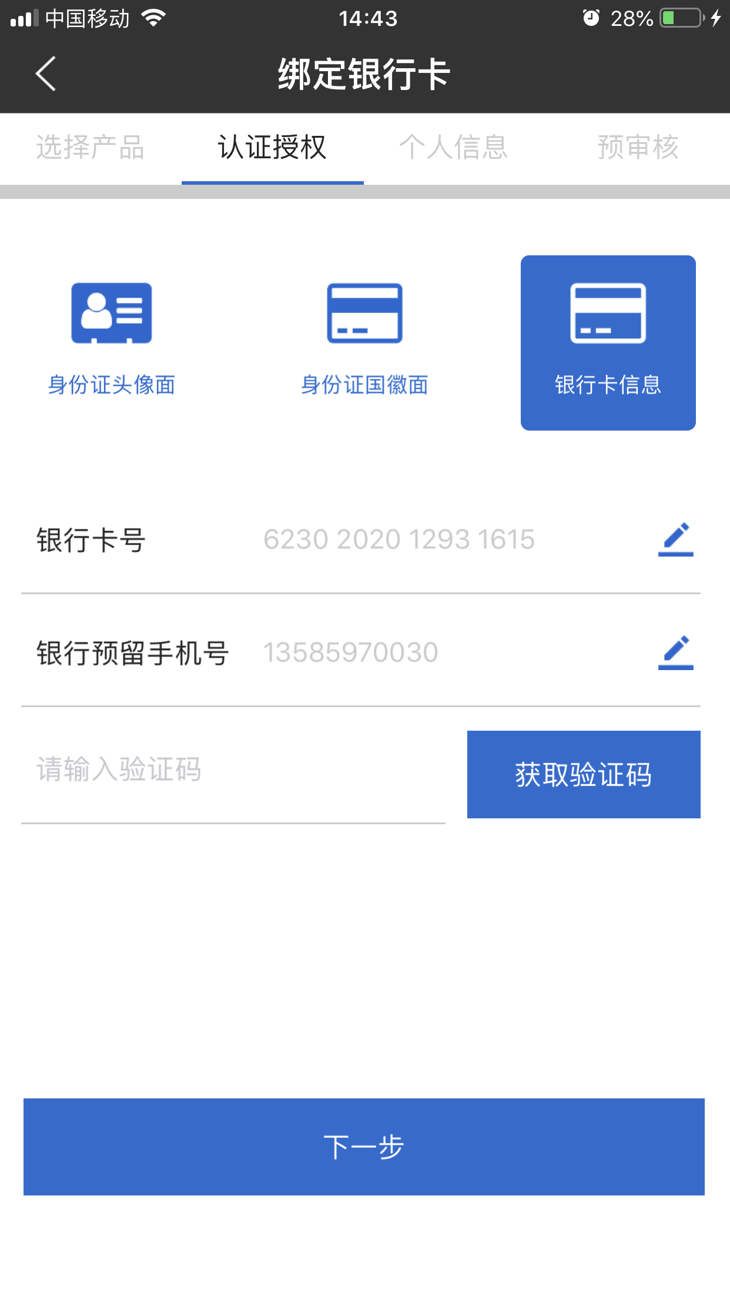

Story ID: EP007-S003-DW
Mockup
OCR Bank Card
Obtain mobile verification code
Bank Card Number and Phone number are editable by the user

Slide 14
Story ID: EP007-S004-DW:
OWNER: PO
Business
Legal
As BMW SF eAPP Owner, I want the eAPP user to perform Face Recognition, so that BMW SF can continue to acquire PBOC authorization from the applicant if he/she passed Face Recognition and Vivo Detection.
Assumptions:
Pre-Conditions:
The user has passed PRC ID (NCIIC) online identity authentication and the ID is valid, user story EP007-S001-DW.
The user has passed Bank Card (China Union Pay) online identity authentication, user story EP007-S002-DW.
Acceptance Criteria:
After the user passed both PRC ID (NCIIC) and Bank Card (China Union Pay) online identity authentication, eAPP will start Face Recognition and PBOC Authorization step.
After the user clicked “Next Step” at the end of EP007-S002-DW, PBOC Authorization content will appear on the applicant screen. “I Agree” and “Decline” buttons will appear at the bottom of the page. In another word, the user can only see the buttons as long as the he/she scrolls to the bottom of the page.
If the user clicks “Decline”, the current page will be closed and the Process Overview page will appear.
If the user clicks “I Agree”, a small window will pop up with the message:“Notice: 1. Next step will ask applicant perform face recognition. 2. Please applicant himself/herself performs the Face Recognition. 3. If the applicant passes face recognition, then the applicant authorizes BMW to check your PBOC personal credit record for application purpose.”. Two buttons appear on the page: “Cancel” and “Start Face Recognition”.
Security
Compliance

Slide 15
Story ID: EP007-S004-DW:
[Cont.] Acceptance Criteria:
If the user clicks “Cancel”, the current page will be closed and the Process Overview page will appear.
If the user clicks “Start Face Recognition”, Face Recognition Services will be triggered and start shooting one face image of the applicant, then compare the image with the photo collected from ID card. (It might change if we can use New Interface from NCIIC.)
If the comparison score passes the “threshold value” set previously, then Vivo Detection will be triggered to verify the applicant is alive. If the Vivo Detection passes, then the Whole Face Recognition succeed, another front-end page will appear:”congratulations, …” (to be continued in next user story EP007-S004-DW.)
If the comparison score does not pass the “threshold value” set previously, then the face recognition fails. eAPP front-end will appear an message: ”Sorry, face recognition failed. Please try once again or contact dealer for help…”
If the comparison score passes the “threshold value” set previously, then Vivo Detection will be triggered to verify the applicant is alive. If the Vivo Detection fails, then the Whole Face Recognition fails, another front-end page will appear:” Sorry, face recognition failed. Please try once again or contact dealer for help…”
For Vivo Detection, two to three actions are must and enough. The actions should appear randomly, such as nod, shake head, open mouth, etc.

Slide 16
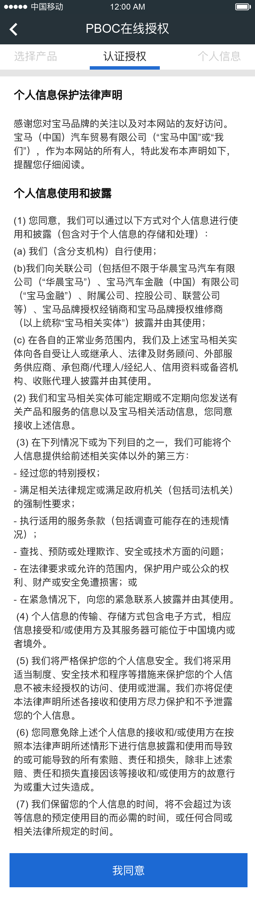
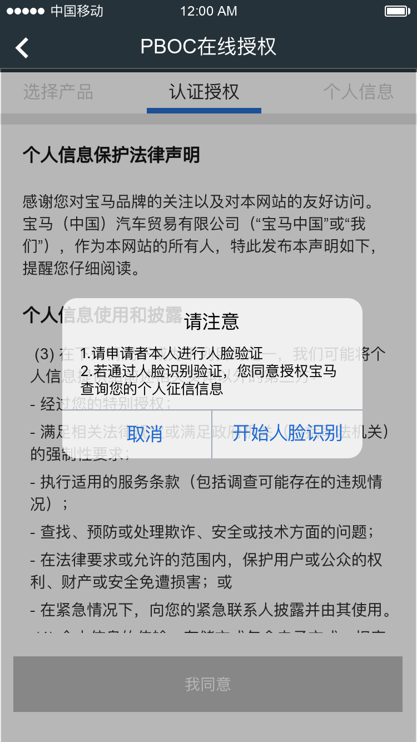

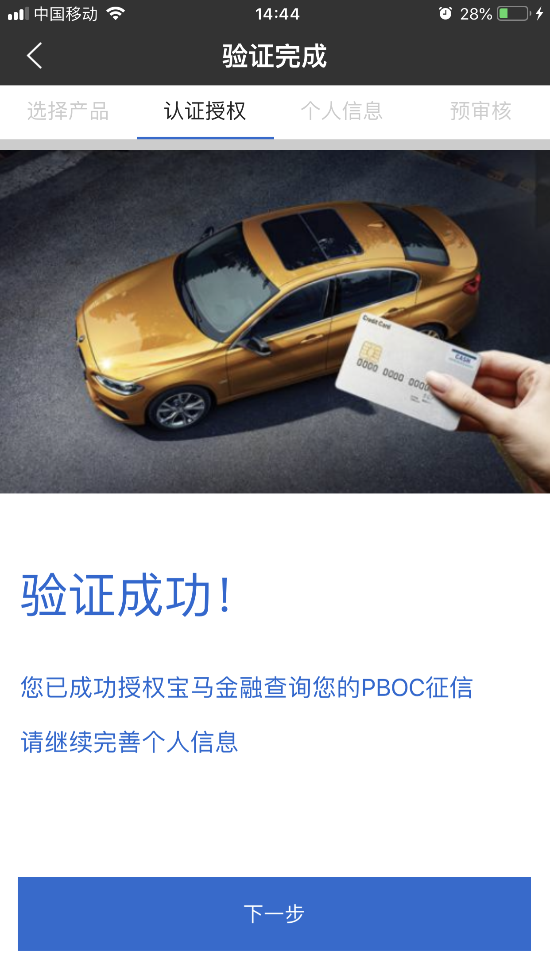



Story ID: EP007-S004-DW
Mockup
Face recognition:
1. Photo Comparison
(with ID Card Photo)
2. Vivo detection
我同意
“I agree” button is only available when customer scroll to the bottom of the page.

Slide 17
Story ID: EP007-S005-DW:
OWNER: PO
Business
Legal
As BMW SF eAPP Owner, I want to show the E-Authentication Result to the user, so that the user can continue or stop the journey. .
Assumptions:
Pre-Conditions:
The user has passed Face Recognition.
The user has filled out the personal information and application form.
Acceptance Criteria:
After the user passed Face Recognition and filled personal information and application form, eAPP will show the Pre-check result to the customer.
(Pre-check Epic will cover the following result.)
Security
Compliance

Slide 18
Story ID: EP007-S006-DW:
OWNER: PO
Business
Legal
As BMW SF eAPP Owner, I want to generate CA for E-Authentication, so that all the customer actions, including authentication and authorization, can be saved as digital evidence.
Assumptions:
Pre-Conditions:
The user has passed Face Recognition.
The user has finished E-Authentication.
Acceptance Criteria:
During customer performs E-Authentication, all the behaviors for customer authentication and authorization should be saved, including ID two side pictures, bank card picture, phone number, PBOC authorization pdf, face recognition video and picture, etc.
After customer successfully finished authentication, CA vendor will generate CA certificate.
CA Certificate should be saved safely.
CA Hardware and Storage solution should be (To be confirmed and discussed with CA Vendor in future).
Below CA process is confirmed with BJCA, one of the CA vendor:
(Next Page)
Security
Compliance
IT

Slide 19
Story ID: EP007-S006-DW:
OWNER: PO
Business
Legal
Continue Acceptance Criteria:
CA Process of E-Authentication (Confirmed with BJCA):
1) 拍摄身份证正反面并通过OCR技术识别，调用NCIIC身份证联网核查；
2) 拍摄银行卡正面并通过OCR技术识别，调用银联银行卡四要素验证；
3) 通过接受手机验证码进行短信验证；
4) 通过摄像头采集人脸照片并进行活体检测，调用人脸识别服务完成人脸识别；
5) 将姓名、身份证号、身份证照片hash、银行卡照片hash、活体视频hash、征信授权书hash一并提交到电子签名系统；
6) 电子签名系统接受信息并生成密钥对，生成证书请求文件；
7) CA系统接受请求文件并签发数字证书；
8) 电子签名系统接受数字证书并对征信授权书电子签名生成电子签名PDF；
9) 宝马接收PDF并传输到相关系统储存。
Security
Compliance
IT

Slide 20
Story ID: EP007-S007-DW:
OWNER: PO
Business
Legal
As an eAPP user, I want to have the information in OSS that was used to do Union Pay Bank Card 5 elements verification in E-Application, so that the information can be prefilled/reused when I do Direct Debit in OSS platform.
Assumptions:
Pre-Conditions:
The user has passed Bank Card (China Union Pay) online identity authentication, user story EP007-S002-DW.
Acceptance Criteria:
After customer successfully passed Bank Card online identity authentication, the information used here should be saved and passed to Direct Debit verification platform (currently it is OSS), including:
Bank Card No.
Name
PRC ID No.
Phone No. for bank registration
Later on, the customer does not need to re-fill the same information, when customer want to use the same bank card to Direct Debit verification process do with bank thru union pay.
Security
Compliance
IT

